Slide 1
ECE 403/531 RF Photonics Project 1
By Samjat Chan

Slide 2
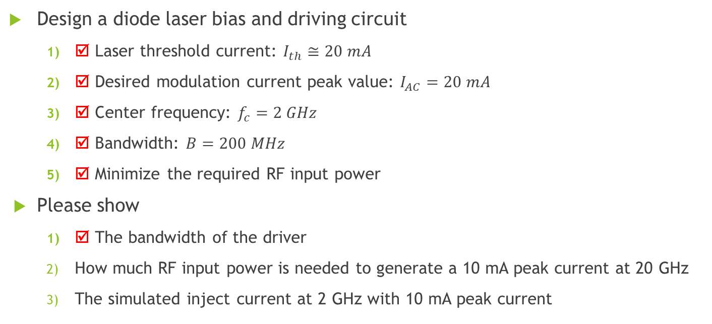
Objective
Design a diode laser bias and driving circuit
☑ Laser threshold current: $I_{th}≅20 mA$
☑ Desired modulation current peak value: $I_{AC}=20 mA$
☑ Center frequency: $f_{c}=2 GHz$
☑ Bandwidth: $B=200 MHz$
☑ Minimize the required RF input power
Please show
☑ The bandwidth of the driver
How much RF input power is needed to generate a 10 mA peak current at 20 GHz
The simulated inject current at 2 GHz with 10 mA peak current

Slide 3
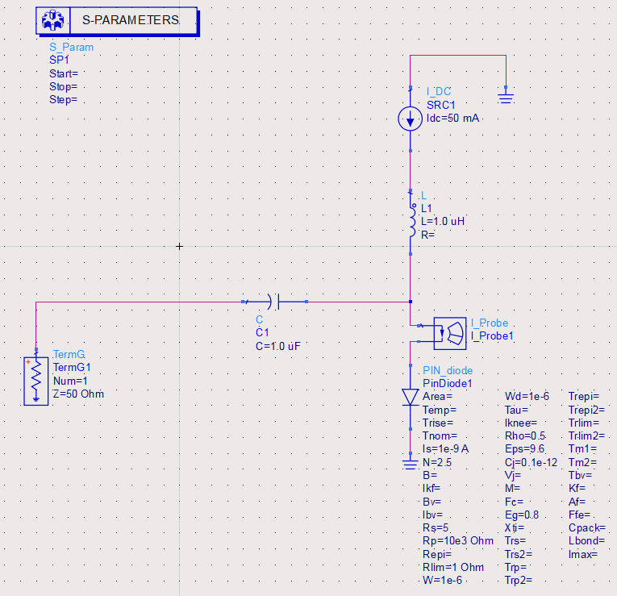
Initial Circuit Schematic

Slide 4
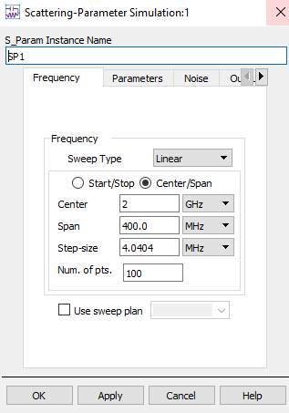
Scatter-Parameter Configuration

Slide 5
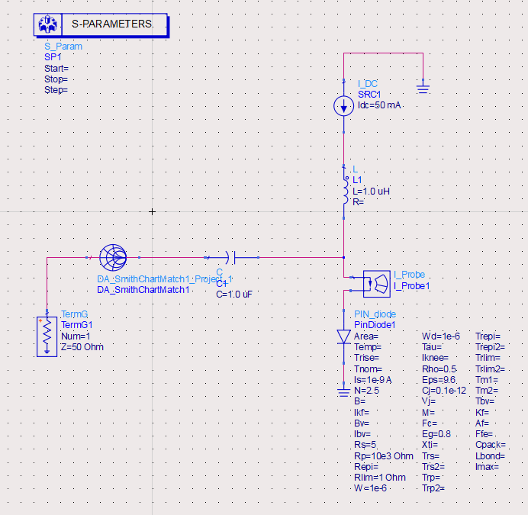
Smith Chart in Circuit

Slide 6
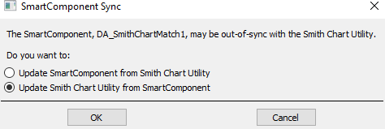
Smith Chart synching

Slide 7
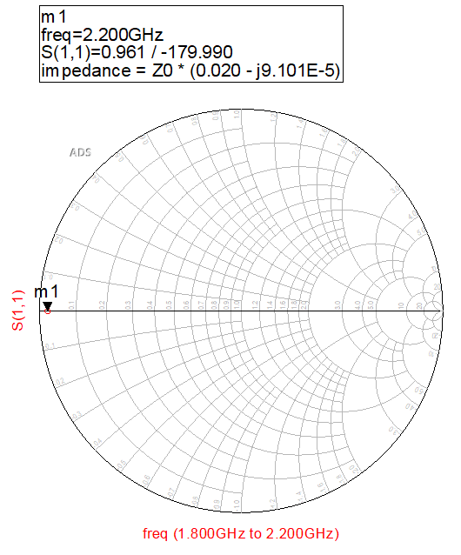
Before Impedance matching
Value of Reflection Coefficient from source at ~2GHz:
S(1,1) = 0.961 <-179.99

Slide 8
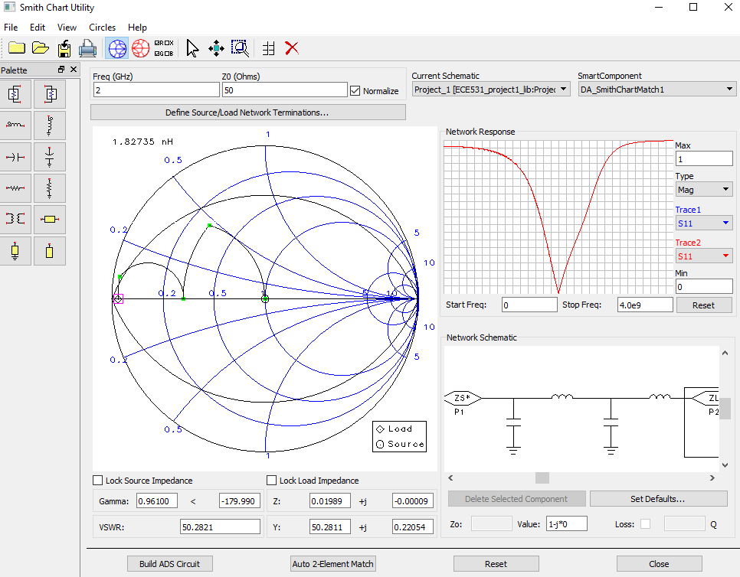
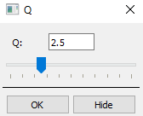
Smith Chart Utility 1
Q-Circle = 2.5
Insert values of S(1,1) into Gamma and <.

Slide 9
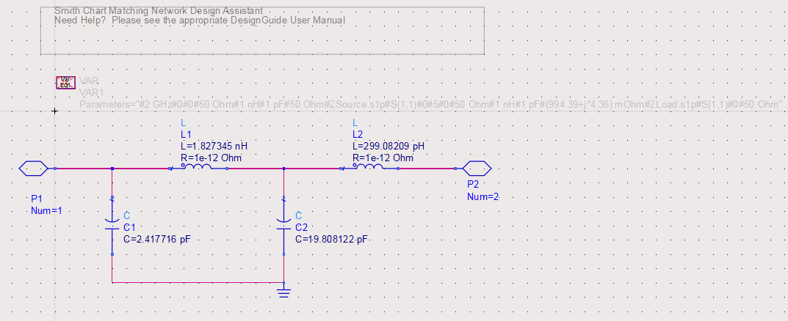
Network Schematic of Smith Chart 1 (Push into hierarchy)

Slide 10
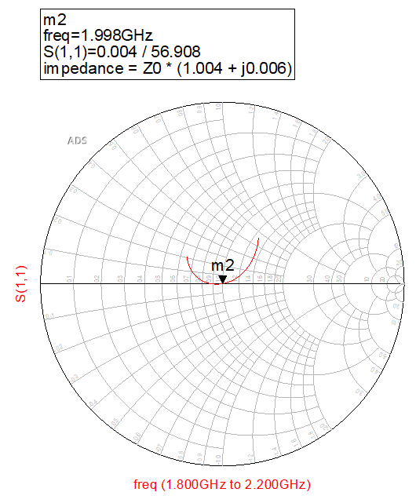
After Impedance Matching
Value of Reflection Coefficient from source at 2GHz:
S(1,1) = 0.004 <56.908

Slide 11
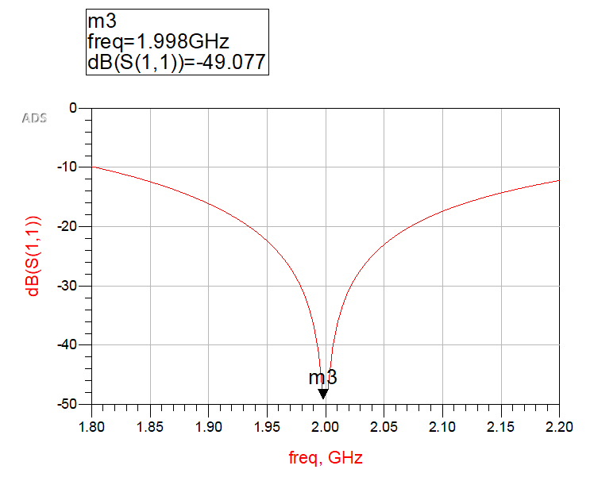

Bandwidth of Driver: $B=2 GHz$

Slide 12
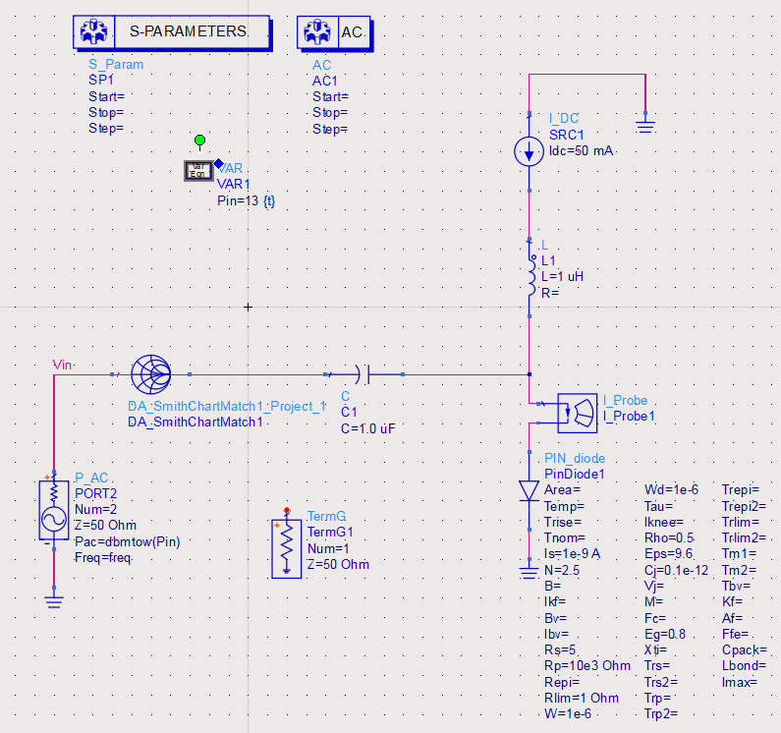
Circuit with AC Power Source

Slide 13
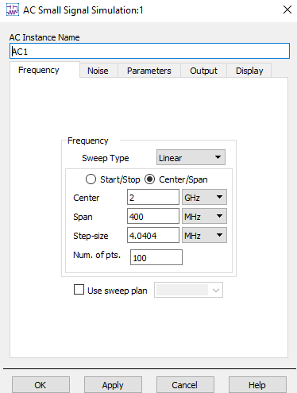
AC Small Signal Configuration

Slide 14
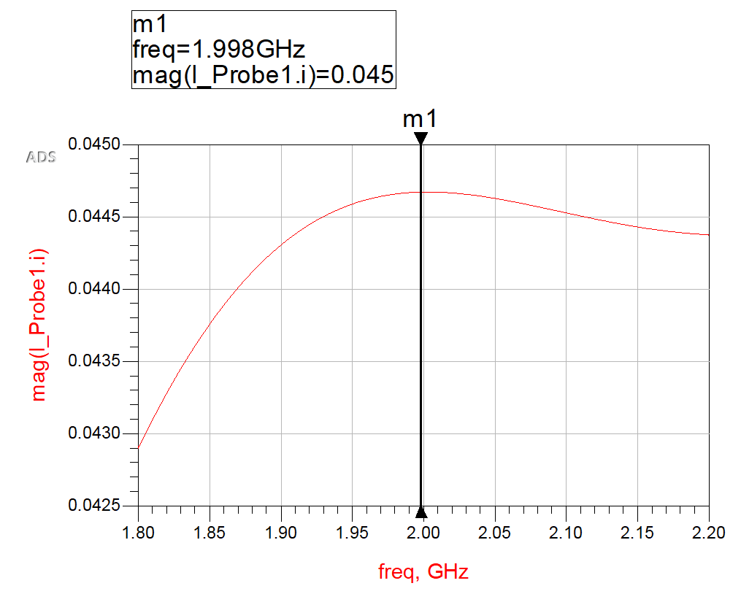
Initial Modulation Current Peak
Tuning required:
Pin

Slide 15
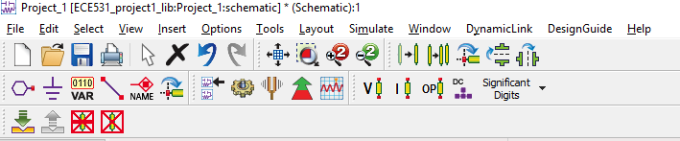
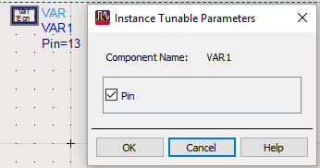
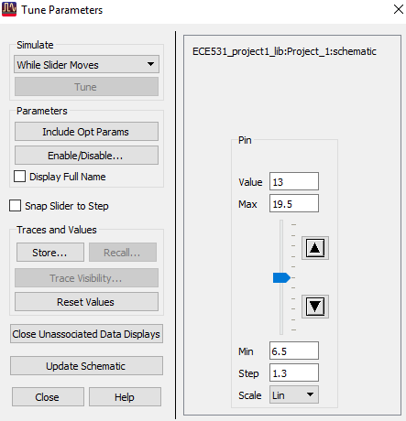
How to Tune Pin
Tuning
Select VAR and check the Pin box
Adjust Pin until it matches the desired modulation current peak plot

Slide 16
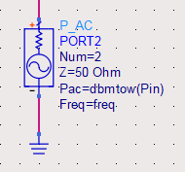
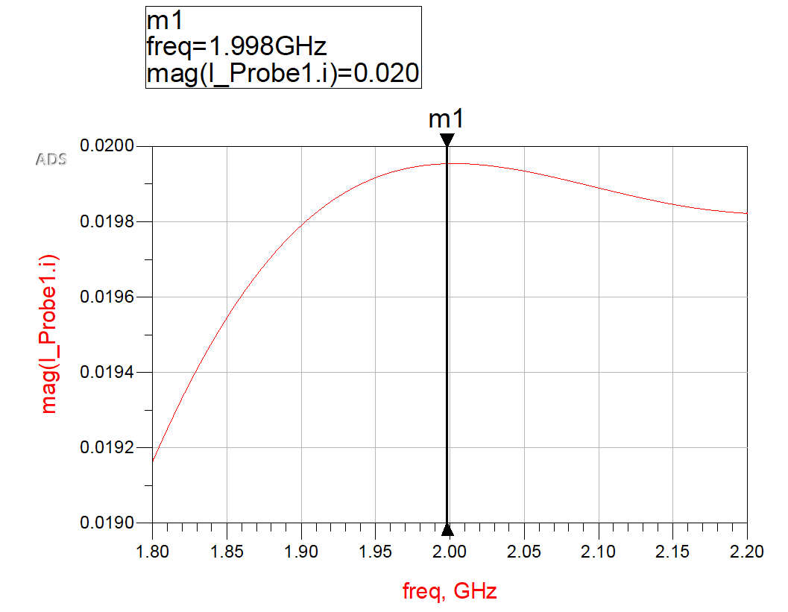


Desired modulation current peak value: $I_{AC}=20 mA$

